Slide 1
Electronics 1 Chapter 2 Midterm 1
Mark Maddox
Electrical Engineering Program
University of Central Florida
mark.maddox@analog.com

Slide 2
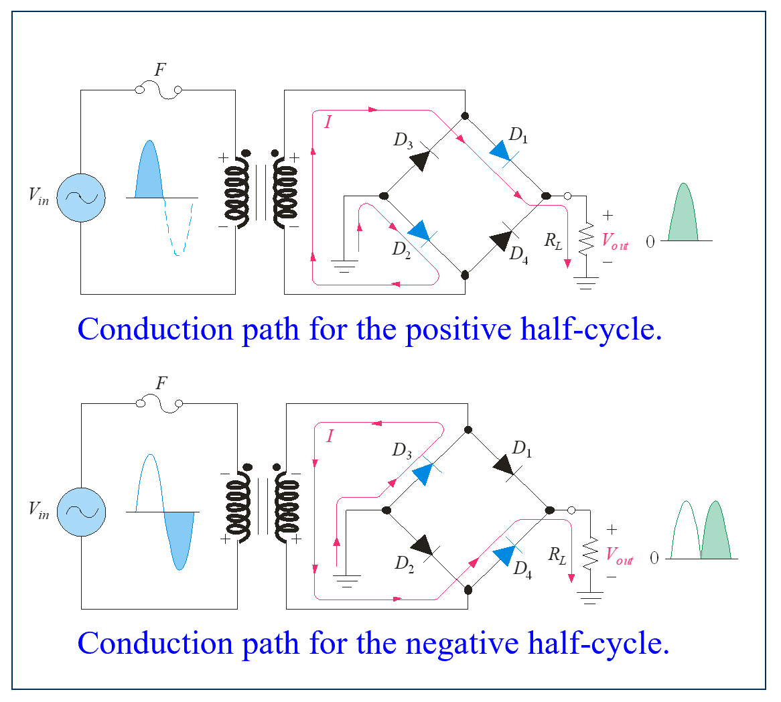
1) For the polarity shown on the primary of the transformer draw the direction that the current will flow in the secondary, through the on diodes, and the load for both half cycles of the input sine wave.

Slide 3
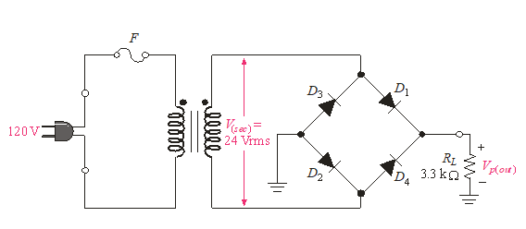
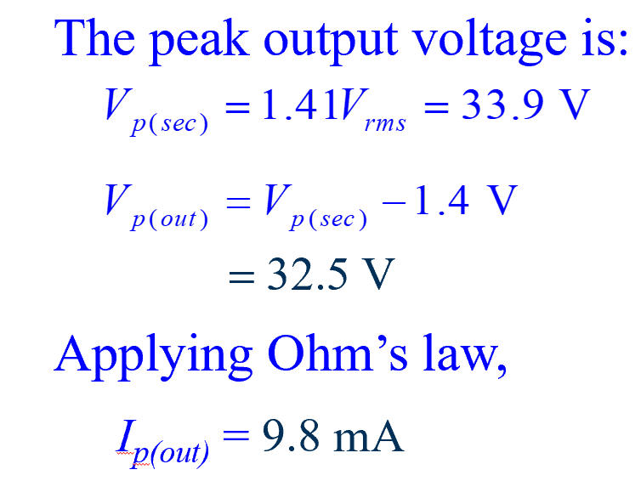
2) Determine the peak output voltage and the peak output current in the 3.3k load
if V_{sec} = 24V_{rms}. Assume the diode turn-on voltage is 0.7v. Note Vp_{(sec)} = 1.414 *
V_{rms}.
1
32.5

Slide 4
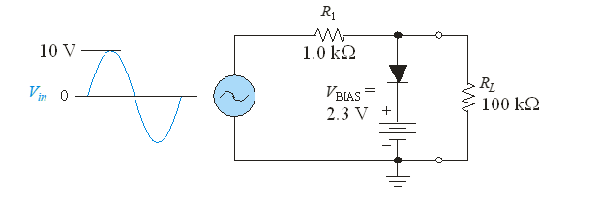
3) Draw the output of the positive limiter/clipper (assuming the diode turn-on voltage is 0.7V) shown below using the following steps,
Draw the schematic when the diode is on and when it is off
Identify what the output V_{RL} is for both circuits
Determine with respect to the input sine wave which of the two circuits is at play then draw the output signal
off
on
3.0v
When the diode is off you have a voltage divider and the output follows the input but scaled at 0.99Vin. The diode will be off for Vin ≤ 3.0v
When the diode is on the output clips at 3.0v. The diode will turn on when Vin ≥ 3.0v

Slide 5
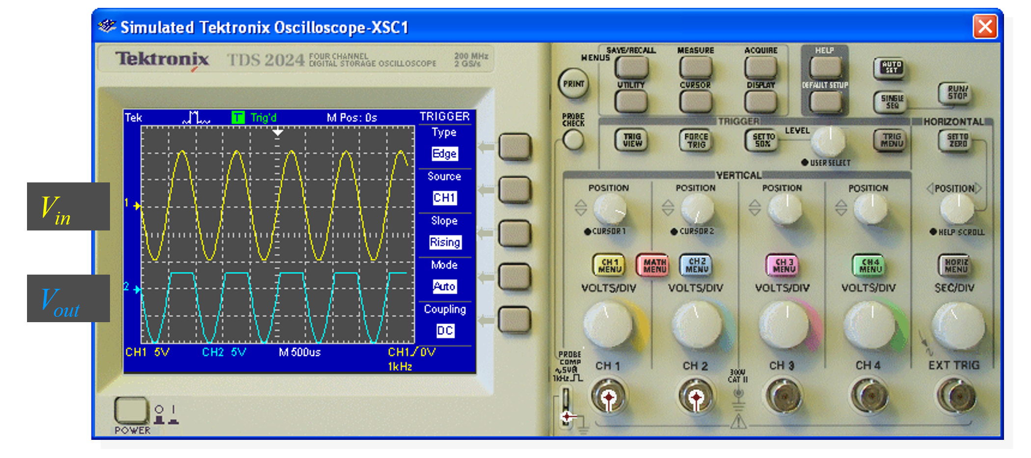
3) Draw the output of the positive limiter/clipper (assuming the diode turn-on voltage is 0.7V) shown below using the following steps,
Draw the schematic when the diode is on and when it is off
Identify what the output V_{RL} is for both circuits
Determine with respect to the input sine wave which of the two circuits is at play then draw the output signal

Slide 6
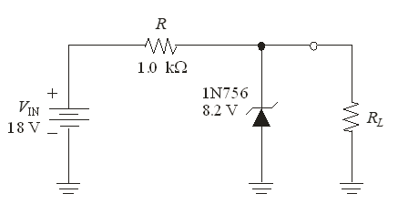
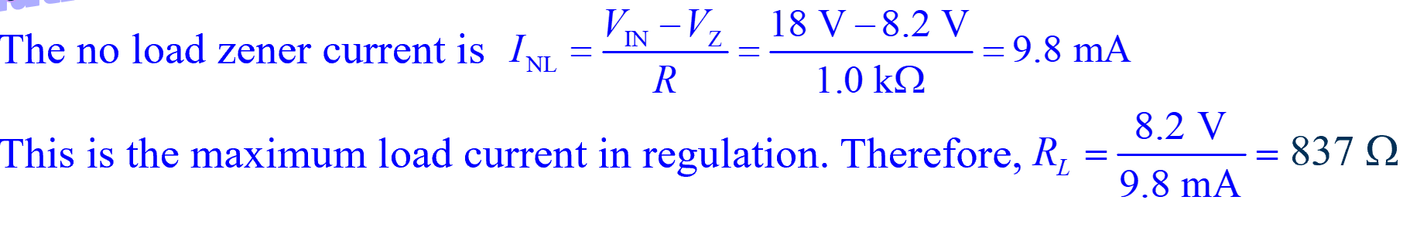
4) Determine the smallest value for R_{L} that can be used to ensure that the Zener shown below can maintain regulation (meaning you have at least 8.2v across the Zener). Hint there are two ways to do this one of which is to find the no-load current then use that value to calculate R_{L} and the other way is the voltage divider equation.
2.0
20
20
5.9
2
1389.8 ohms
5.9
Alternatively, you could use the voltage divider equation to see what value of R_{L} will place 8.2v across the Zener,
8.2v = 18v(R_{L} / (R_{L} + 1k)) solving for R_{L} we get 837 ohms
20
2
1389.8

Slide 7
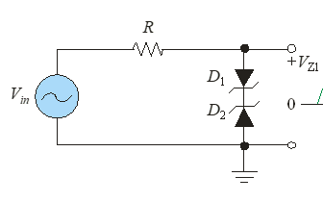
5) What is the maximum positive and negative output voltages in the circuit below if the Zener breakdown voltage is 5.6v and the diode turn-on voltage is 0.7v?
± 6.3 V

